Slide 1
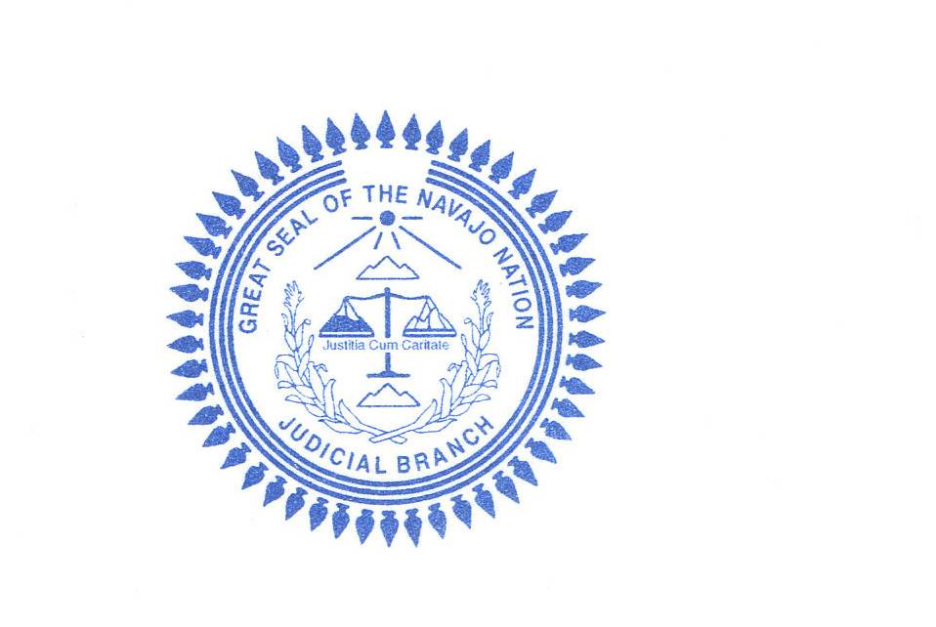
Navajo nation judicial branch Quarterly Judicial Conference
To’Hajiilee, New Mexico
October 29, 2010
Updated July 29, 2016

Slide 2
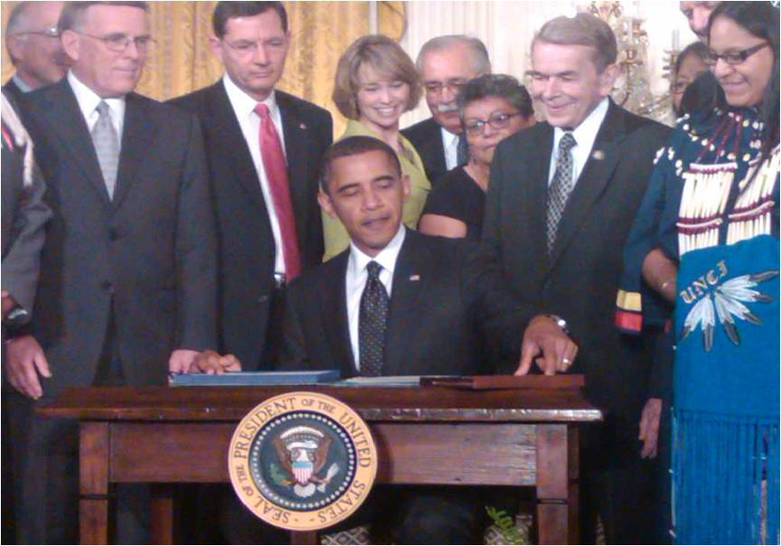
Summary and Explanation of Provisions in the Tribal Law and Order Act of 2010
Public Law 111-211 – July 29, 2010

Slide 3
Tribal Law and Order Act
Signed into Law by President Barrack Obama on July 29, 2010.
Sponsored by Senator Bryon Dorgan (D-N.D) Bill HR 725
Initiated in 2007 when Sen. Dorgan met with tribal leaders – majority of leaders stated that public safety was their number one priority.
Held 15 Senate hearings (2007-2010) – found epidemic domestic and sexual violence; federal prosecution declinations and lack of federal response; gangs targeting reservations; low police presence, limited training, difficulties with recruitment and retention of police officers.

Slide 4
Tribal Law and Order Act
Other findings: Crisis of violence on many reservations: violent crime rates are more than 2x the national average across IC and up to 20x the national average in some tribal communities.
DV/SA in IC reached epidemic levels where 34% of Indian women will be raped in their lifetime and 39% will suffer partner violence.
Less than 3000 police officers patrol more that 56 million acres of IC.

Slide 5
Tribal Law and Order Act
Primary Causes
1 - Broken and Divided System
    Handcuffed tribal justice systems
    Lack of federal accountability to tribes
    Jurisdictional maze
2 – Underfunded Tribal Justice System
Crafting a Solution
Senator Dorgan introduced TLOA on April 2, 2009
Comprehensive approach to reforming system; tribal and federal

Slide 6
Tribal Law and Order Act
Indian Arts and Crafts Amendments Act 2010
Domestic Violence & Sexual Assault in IC
Tribal Courts, Justice Systems & Tribal Sovereignty
Federal Accountability, Consultation & Coordination
Programmatic Improvements to Aid Tribal Justice Systems
Tribal Police Recruitment, Training & Retention

Slide 7
Indian Arts and Crafts Amendments Act of 2010

Slide 8
Indian Arts & Crafts Amendments Act - Overview
Offense: Misrepresentation of Indian produced goods and products.
Offered or displayed for sale - $1000 or less
1st Offense: Individual - $25,000 fine/1yr. jail
Not an individual - $100,000 fine
Offered or displayed for sale - $1000 or more
1st Offense: Individual - $250,000/5 yrs. jail
Not an individual - $1,000,000 fine

Slide 9
Indian Arts & Crafts Amendments Act - Overview
Offense: Misrepresentation of Indian produced goods and products.
2nd or Subsequent Offense: Individual – 15 yrs. Jail.
Not an individual - $5,000,000 fine
Federal law enforcement officer, including cross commissioned can investigate.
Federal, Tribal or State prosecution allowed.
Civil Litigation allowed – money damages.

Slide 10
Domestic Violence & Sexual Assault in Indian Country

Slide 11
Domestic Violence and Sexual Assault in indian Country
34% of American Indian and Alaska Native women will be raped or sexually assaulted and 39% of Native women will suffer domestic or partner violence. To address this epidemic, the Act does the following:

Slide 12
Tribal Law and Order Act
(Section 212) Requires FBI and US Attorneys to maintain data when declining to prosecute a violent crime in Indian Country, which will encourage more aggressive prosecutions of rapes and sexual assaults.
(Section 212) This same provision requires FBI and US Attorneys to share evidence with tribal justice officials that have concurrent jurisdiction over the alleged crime to enable the Tribe to pursue the case in tribal court.

Slide 13
Tribal Law and Order Act
(Section 213) Authorizes appointment of tribal prosecutors as Special Assistant US Attorneys to prosecute minor crimes and crimes not subject to tribal court authority (example: non-Indian domestic violence) in Federal Court.
(Section 234) Increases tribal sentencing authority up to 3 years per offense to enable tribes to prosecute domestic violence and sexual assault (DV/SA) that are not prosecuted in Federal Court.

Slide 14
Tribal Law and Order Act
(Section 261) Requires US Bureau of Prisons to notify tribal authorities when releasing a sex offender that will work or reside in Indian Country.
(Section 262) Requires federal officers working in Indian country to receive training in handling DV/SA cases to improve interview techniques and crime scene/evidence handling.

Slide 15
Tribal Law and Order Act
(Section 263) Requires Indian Health Service (IHS) and Bureau of Indian Affairs (BIA) officials to testify in tribal court about information gained in the scope of their employment to aid in prosecutions of DV/SA cases. (current regulations permit Federal officials to ignore tribal court subpoenas as FOIA requests)
(Section 265) Requires IHS, BIA and DOJ-VAWA to standardize protocol on the handling of all aspects of sexual assault cases in Indian country.
(Section 266) Requires the Government Accountability Office to examine the capacity of rural IHS facilities to handle sexual assault cases.

Slide 16
Tribal Courts, Justice Systems & Tribal Sovereignty

Slide 17
Tribal Courts, Justice Systems & Tribal Sovereignty
Indian Tribes are the first responders to crime in Indian Country. However, federal laws limit the ability of Tribes to combat crime on Indian lands: tribal courts are hampered by the one-year sentencing limit; tribal police arrest authority is limited to only members of federally recognized Tribes; and the tribal police are in some cases not provided access to national criminal history databases. To address these disparities, the Act does the following:

Slide 18
Tribal Law and Order Act
(Section 234) Amends the Indian Civil Rights Act (IRCA) to enhance sentencing authority of all federally recognized Indian Tribes up to 3 years in jail per offense and clarifies that tribal court can subject offenders to multiple charges (9-year maximum/$15,000 fine). When a tribal court charges an offender to more than 1-year in jail, the Tribe must:
Provide licensed legal counsel to the defendant. (licensed by any jurisdiction – Tribe, state or federal licensing authority)

Slide 19
Tribal Law and Order Act
Ensure that tribal court judges presiding over 1+ year cases are licensed and have sufficient legal training to preside over criminal cases. (same licensing standards as above).
Tribe must have published criminal laws, rules of evidence and rules of criminal procedure.
Maintain audio and/or video record of criminal trial.
Cases that are not subject to more than 1-year in jail will be subject to the current Indian Civil Rights Act requirements.

Slide 20
Tribal Law and Order Act
(Section 212) Requires US Attorneys that decline to prosecute violent reservation crimes to share evidence with tribal prosecutors to aid in tribal court prosecutions.
(Section 231) Enhances ability to deputize tribal police officers to enforce violation of Federal law in Indian country. [Special Law Enforcement Commission - SLEC]
Requests BIA to provide regional trainings to educate and certify tribal police officers to enforce Federal laws.

Slide 21
Tribal Law and Order Act
Requires BIA to establish criteria to enter into MOA’s with Tribes for the Special Law Enforcement Commissions.
Requires MOA’s to provide certified officers with Federal Tort Claims protection for actions within the scope of their duties and treat tribal police as federal officers. (which will subject assaults on tribal police officers as Federal felonies)
Sets timeline of 60 days to approve MOA’s when a Tribe meets all criteria.

Slide 22
Tribal Law and Order Act
(Section 231 cont.) Tribal police officers who obtain deputized will gain authority to:
Cite all offenders of Federal law on tribal lands (Indian and non-Indian)
Issue Central Violations Bureau citations for non-violent crimes.
Make warrantless arrests when an officer has probable cause to believe that a crime has occurred in a broader array of cases – placing tribal police authority on par with Federal and State police.

Slide 23
Tribal Law and Order Act
(Section 233) Clarifies that tribal police are “authorized law enforcement official[s]” for purposes of accessing the National Crime Information Center (NCIC) and improves access to all Federal criminal history databases.
(Section 251) Mandates tribal police access to the National Gang Intelligence Center database.
(Section 252) Make tribal governments directly eligible for DOJ Criminal History Record Improvement Grants.

Slide 24
Tribal Law and Order Act
(Section 221) Public Law 83-280. Clarifies that all federally recognized Indian Tribes (including those in P.L. 280 States) have concurrent criminal authority over reservation crimes involving Indian offenders. Same provision authorizes Tribes subject to P.L. 280 to call on US Attorneys where the State or local government does not have the resources or will to investigate or prosecute violent reservation crimes.

Slide 25
Federal Accountability, Consultation & Coordination

Slide 26
Federal Accountability, Consultation & Coordination
The United States has a treaty, trust and Federal statutory obligation to provide public safety for Tribal justice systems and to work with them to combat crime in Indian Country. The Act establishes and strengthens standards to hold the U.S. to its obligations.

Slide 27
Tribal Law and Order Act
(Section 212) FBI and US Attorneys will share evidence with tribal justice officials when terminating investigations or declining to pursue a case in Federal Court.
(Section 212) The Attorney General will maintain data on all case terminations and declinations and report to Congress annually.
(Section 213) Codified the use of Tribal Liaisons at each Federal District within Indian country and requires Liaisons to consult and coordinate with tribal justice officials, and provide technical assistance to improve the ability of Tribes to respond to reservation crime.

Slide 28
Tribal Law and Order Act
(Section 211) Bureau of Indian Affairs response, consultation and coordination:
Requires BIA-Office of Justice Services (OJC) to share crime data with DOJ.
Requires BIA-OJS to submit to Congress, annual public safety spending and unmet needs reports on a wide range of public safety items.
Requires BIA-OJS to consult on a regular basis with tribal communities on public safety concerns and development of policies that affect public safety.

Slide 29
Tribal Law and Order Act
(Section 213) Urges Federal Courts to hold trials in Indian country to permit the tribal community to see justice be done at home rather than hear about cases in Federal Courts that are often hundreds of miles from the scene of the crime.
(Section 214) Makes permanent the Office of Tribal Justice within DOJ to serve as the policy advisor to the Attorney General to uphold US Government’s treaty, trust and statutory obligations to Indian Tribes.

Slide 30
Tribal Law and Order Act
(Section 251) Requires DOJ Director of Bureau of Justice Statistics [in coordination with Tribes and BIA-OJS] to submit an annual report to Congress on crime in Indian country.
(Sections 211 & 245) Requires DOJ and BIA-OJS in coordination with Tribes to develop a long-term plan for the construction, maintenance and operation of tribal adult and juvenile detention and alternative rehabilitation centers.

Slide 31
Programmatic Improvements to Aid Tribal Justice Systems

Slide 32
Programmatic Improvements to Aid Tribal Justice Systems
Tribal justice systems are the first responders to Indian Country crime and the U.S. has acknowledged that part of the obligation to provide reservation public safety including the ability of tribal governments to combat crime locally. To better meet this obligation, the Act reauthorizes and amends a number of Federal programs designed to empower all aspects of tribal justice systems.

Slide 33
Tribal Law and Order Act
(Section 241) Substance Abuse Prevention. More than 90% of crimes in Indian Country are alcohol and substance abuse related. The Act reauthorizes and amends the Indian Alcohol and Substance Abuse Act (IASA) which authorizes grants for summer youth programs, development of tribal juvenile codes and construction of shelters and detention and treatment centers for at risk youth. It directs the Substance Abuse and Mental Health Service Administration (SAMHSA) to take the lead role in interagency coordination on tribal substance abuse programs. SAMHSA is authorized to establish and appoint a Director of the Office of Indian Alcohol and Substance Abuse that will develop a framework for interagency communication and provide technical assistance to tribal governments to develop and enhance alcohol and substance abuse prevention programs.

Slide 34
Tribal Law and Order Act
(Section 242) Tribal Courts. Reauthorizes and amends the Indian Tribal Justice Support and Technical & Legal Assistance Acts which provide funding for tribal court judicial personnel, public defenders, court facilities, development of records management systems and other needs of the tribal court systems.
(Section 245) Rehabilitation of Federal Offenders. The Act authorizes the appointment of Indian country residents (individuals) to serve as assistant Federal Probation Officers to monitor offenders living on or reentering Indian lands. This provision also encourages U.S. Courts to offer services on or near Indian lands.

Slide 35
Tribal Law and Order Act
(Section 246) Juvenile Justice. Reauthorizes and amends the Juvenile Justice and Delinquency Prevention Act of 1974 within DOJ, expanding grant activities to include delinquency prevention, treatment and rehabilitation of juvenile offenders. This provision also adds an expert in tribal juvenile services to the Coordinating Council on Juvenile Justice.
(Section 243) Tribal Police. Amends the Omnibus Crime Control and Safe Streets Act of 1968 within DOJ. The Community Oriented Policing Services Office (COPS) is reauthorized and removes time limits on hiring grants [previously 3-5 years], removes matching funds requirements and permits tribes to use funds to cover indirect costs.

Slide 36
Tribal Law and Order Act
(Section 244) Tribal Jails and Justice Centers. Reauthorizes and amends the Violent Crime Control and Law Enforcement Act of 1994. Authorizes funding for regional detention centers for long-term incarceration and tribal justice centers that combine courts, police and corrections services.
(Section 247) Alaska Native Villages. Repeals a FY-2004 appropriation rider to make all Federally recognized Tribes in Alaska eligible for DOJ tribal courts and COPS grants.

Slide 37
Tribal Police Recruitment, Training & Retention

Slide 38
Tribal Police Recruitment, Training & Retention
Less than 3000 BIA and Tribal police officers patrol over 56 million acres of Indian lands. Less than half of the police force needed. Offenders are aware of the shortfalls and are targeting reservations for drug trafficking. The lack of police also causes significant delays in responding to victims’ calls for help. To address this, the Act provides the following:

Slide 39
Tribal Law and Order Act
(Section 231) Expands the hiring age of Bureau of Indian Affairs police officers from 37 to 47 to enable retired military personnel to become law enforcement officers within Indian country upon their retirement.
(Section 231) Expands BIA and tribal police training opportunities to Tribal, State and local police academies and universities where such programs meet Peace Officer Standards and are consistent with Federal Law Enforcement Training Standards.
(Section 231) Expedites Tribal requested background checks for BIA police candidates and corrections candidates hired under 638 [Self-Determination] contracts; background check must be completed within 60 days.

Slide 40
Challenges for Navajo Nation

Slide 41
Challenges for Navajo Nation
- Lack of available cells to house inmates. While the facilities have been built, the lack of correction officers means they cannot be fully utilized and early releases still have to occur.
Jails have to be certified by BIA – no provisions for certification in TLOA.
Long term detention facilities need to have more rehabilitative services and the ability to maintain health of prisoners.
- Insufficient current consultation between tribal departments.
- Insufficient current consultation between NN and Feds.
- Criminal statutes need to be revised – requires legislative action and consultation.
- PPS: need to consult with Fed PPS on standard reporting systems.

Slide 42
Challenges for Navajo Nation
- Criminal procedures need to be reviewed and possibly amended.
- Prosecutors need to meet same requirements as AUSA’s for special appointments – if needed.
- Police need to review current certifications and possibility of cross commission.
- No funding mandate for implementation for Tribes
- TLOA lacks regulations – guidelines are still not fully developed.

Slide 43
Challenges for Navajo Nation
TLOA funding may affect 638 funding – reduction in 638 funding a possibility.
Additional funds will be needed to address long term inmates that will be prosecuted by the tribe and no longer prosecuted and detained in the federal system.
- - 100% funding for courts is unheard of – usually 40%; might need additional justifications.
Habeas corpus always a possibility.
Funding under the TLOA has still not addressed tribal needs. (see handout)

Slide 44
CHALLENGES FOR NAVAJO NATION CONTINUED
The Bureau of Prisons, Tribal Prisoner Pilot Program which allowed for the incarceration of up to one hundred tribal members is not operating. The Program ended in November 2014, a total of six inmates were in the program.
The Program had allowed tribal judges to direct sentence offenders to a long term federal facility.
Program was designed to expire four years from being implemented unless it was renewed.

Slide 45
Conclusion and Recommendation
Conclusion: TLOA addresses many areas of the NN justice system, but there needs to be continued consultation between departments, i.e. courts, corrections, police, prosecutor, public defender, social services and any other affected department to see if implementation is possible.
Consultation between NN and Fed is also necessary.

Slide 46
Contact Information
Hon. William J.J. Platero
(505) 908-2818
Dan Moquin , Staff Attorney
(505) 775-3218

Slide 47
VIOLENCE AGAINST WOMEN RE-AUTHORIZATION ACT OF 2013
The Act was passed on March 7, 2013.
It recognized the inherent power of tribes to exercise “special domestic violence criminal jurisdiction” (SDVCJ) over certain defendant that were non-Natives.
Inherent authority is important since it avoids a double jeopardy challenge
The authority allows tribes beginning March 7, 2015 to prosecute non-Indians for domestic violence and dating violence and for violating tribal domestic violence orders

Slide 48
Requirements
Must give defendants the rights that are contained in the Indian Civil Rights Act as amended by the Tribal Law and Order Act
Thus to prosecute Non-Indians Tribe must be in compliance with TLOA requirements explained in the TLOA presentation

Slide 49
NOT COVERED
Crimes committed outside of the Reservation or what is defined as Indian Country
Crimes involving two non-Indians regardless of location of the crime
Crimes between strangers even if the crime is a sexual assault
Crimes committed by a person lacking a sufficient tie to a tribe such as working or living on the reservation
Child or elder abuse of person not covered by protective order

Slide 50
Pilot Progam
The pilot programs were available prior to March 7, 2015 for the prosecution of Non-Indians. The Navajo Nation did not opt to be in a pilot program the requirements to participate were the same as described in TLOA but to repeat:
Follow the protections of the Indian Civil Rights Act of 1968.
Follow the Requirements of the Tribal Law and Order Act of 2010

Slide 51
Requirements continued
TOLA requirements:
Effective assistance of counsel for defendants
Free appointed, licensed and law trained advocates for indigent defendants
Criminal laws and procedures publicly available for defendants and advocates
Recorded hearings available for judicial review
Jury pools that reflect broad section of community including non-Indians
Inform defendants of right to file federal habeas corpus petitions

Slide 52
TRIBES INVOLVED IN PILOT
Tribes involved include:
On February 6, 2014:
Pascua Yaqui Tribe of Arizona
Tulalip Tribes of Washington
Umatilla Tribes of Oregon
Later these tribes joined:
Assiniboine and Sioux Tribes of Fort Peck Indian Reservation in Montana
Confederated Tribes of the Umatilla Indian Reservation of Oregon

Slide 53
CHANGES NOT REQUIRING TRIBAL CONSENT
VAWA allows for the federal prosecution of Defendants who have two prior convictions for domestic violence including tribal convictions
The United States Supreme Court heard a challenge around one month ago. The challenge asserted that the tribal convictions violated due process because the Defendants did not have counsel before the tribal courts. The Supreme Court unanimously overturned the Ninth Circuit Court and held that the federal prosecution did not violate due process.
Justice Ginsberg wrote the opinion.

Slide 54
Changes continued
The strangulation of an intimate partner was made a federal crime in Indian country by section 906 of VAWA. The U.S. Attorneys office has prosecuted many cases in Indian country
Section 402 of VAWA provided for grants to tribes to prevent domestic violence and sexual related assaults.

Slide 55
CONTACT INFORMATION
Dan Moquin , Staff Attorney
Ramah Judicial District, (505) 775-3218
dgmoquin@yahoo.com

